Slide 1
VSMi Roadmap

Slide 2

Other Modules In This Series
5S
Standard Work
Total Productive Maintenance (TPM)
Cell Design/ Production Preparation Process (3P)
Intro to Lean
Kaizen
Kanban
Problem Solving
Poka Yoke Quality Systems
Process Mapping
Single Minute Exchange of Dies (SMED)
Transaction Process Improvement (TPI)
Value Stream Mapping (VSMi®)
Visual Management
For More Information Please Contact:
Mark DeLuzio, President and CEO
+1.860.234.0915
mark.deluzio@leanhorizons.com
Strategically Creating Value Through the Elimination of Waste
2

Slide 3
This document contains confidential
and proprietary information owned
by Lean Horizons Consulting, LLC.
Any disclosure, use, copying or
distribution of this information without the express written consent of Lean Horizons Consulting is strictly prohibited.

Slide 4
Value Stream Mapping Defined
VSM is a snapshot of all actions both value added and non-value added
required to bring a product or service through the main material
and information flows
Key Characteristics
Components of VSM
VSM is a graphical representation that uses a common mapping language
VSM provides the basis and direction for identifying improvement opportunities
Conducting VSM does not in and of itself yield any improvements… the power is in the plan!
Current State Value Stream Map
Mark-Up of Current State
Value Stream Map
Future State Value Stream Map
Value Stream Plan
Notes:
DO: Read through important points on the slide and identify the basic components of VSM.
SAY: “It is important to note that our event this week will not yield any realized improvements or results. This tool simply gives the picture of what the improved process could be if the business completes the identified actions and kaizen to get there.”

Slide 5
The “i” in VSMi
VSMi is about identifying and eliminating waste associated with the flow of information
Information flow is defined as adding to, subtracting from, interpreting, or reformatting information
Information must arrive at the to the right place, at the right time, and to the right person
Processes today are not designed around information flow
Notes:
SAY: “With discreet information flow, we still add to, subtract from, interpret and reformat information, but we create information along the way as well.”

Slide 6

Detailed graphical depiction of a manufacturing or business process
Used to identify specific improvements
Incorporates decision loops within the process
Value Stream Map and Process Map Distinction
Value Stream Map
VALUE STREAM MAP
I
I
High-level snapshot of end-to-end
business
Used to identify where opportunities for improvement exist
Does not incorporate decision loops
6
Notes:
SAY: “A Value Stream Map is the “30,000-foot” view of the process. A Process Map is a tool that would take just one process box from a Value Stream Map, and explode that process into it’s detailed steps.”

Slide 7
When to Use Value Stream Mapping
To effectively use of the Value Stream Mapping Tool and Method to clearly
identify waste in key end-to-end manufacturing and business processes,
and create an executable transformation plan
Benefits
When to Use
Focuses limited resources
Establishes timeline for expected performance improvements
Avoids creating islands of success in a sea of waste
Allows everyone gain a common understanding of the current state and the future vision
To provide direction for getting started on the Lean journey
To execute improvements driven by Strategy Deployment and Key Business Imperatives
To gain true cross-functional understanding the end-to-end process
Notes:
SAY: “So why are we here? What do we want to accomplish?”
SAY: “If I am going to improve the “<fill in with your event> Process, what do I do first? VSM gives you the focus.”
DO: Cover points on the slide.

Slide 8
Value Stream Mapping Linkage to Strategy
Make Improvements
that
Eliminate Waste:
Key
Business
Imperatives
Identify
and Map
Value Streams
Identify strategic
objectives and major
business improvement
opportunities
WASTE
8
Notes:
SAY: “It is critical to understand that Value Stream Mapping is a tool that is used to execute our Key Business Imperatives for Business Strategy. VSM helps identify the waste so that improvements can be made to eliminate the waste.”

Slide 9
Value Stream Mapping Roadmap to Success
Repeat for each identified Value Stream
PROCESS STEP 1
PROCESS STEP 2
PROCESS STEP 3
PROCESS STEP 4
Site Assessment
VSM Event
Preparation
Conduct
VSM Event
Implement
VS Plan
Repeat
Cycle
Complete Intro to Lean
Identify Strategic Value Streams and Product Families
Plan VSM Events
Complete Intro to Lean
Select Value Stream and Product Family
Confirm VSM Team
Plan logistics for VSM Event
Current State VSM
Future State VSM
Value stream Plan complete
Site Plan updated
Plan kaizen events that link to VS Plan
Train Kaizen Teams
Conduct kaizen events and measure results
Manage VS Plan to completion
9
Notes:
DO: Review the VSM Roadmap. Cover what has taken place already, where we are in the process, and where we will go from here.
DO: Stress that this is an iterative process. VSM is typically a 6 month cycle… then when your future state becomes your new current state, you begin again.
DO: Stress that each of these process steps are not equal in length. They are separate, necessary steps. Step 4 is a 6 month cycle that is filled with kaizen events and other improvement activities that target achieving the future state.
SAY: The personnel in Step 2 in most cases will be different or “in addition” to those in Step 1, this is why the Intro to Lean will be conducted at both steps.

Slide 10
Value Stream Mapping Process
Repeat for each identified Value Stream
PROCESS STEP 1
PROCESS STEP 2
PROCESS STEP 3
PROCESS STEP 4
Site Assessment
VSM Event
Preparation
Conduct
VSM Event
Implement
VS Plan
Repeat
Cycle
Select Product
or
Service Family
Create
Current
State Map
Interrogate
the
Current
State
Create
Future
State Map
Develop
Value
Stream Plan
10
Notes:
SAY: “This week we are at Process Step 3. The steps to conducting a VSM Event are:
1 – Select Product or Service Family (this has been done)
2 – Create the Current State Map – again, the snapshot of the process today
3 – Interrogate the Current State – here we will analyze the Current State for improvement opportunities
4 – Create Future State Map – based on the improvements we want to make – what will the future process look like
5 – Develop the Value Stream Plan – here is where we detail what specific objectives need to be accomplished in order for the Future State to be achieved.
Realize that when we are complete this week’s event – no improvements will actually be made… it is not until the action plan gets implemented that we will see results. “

Slide 11
Value Stream Mapping Session Agenda
Day | Key Learnings | Daily Deliverables
Day 1 | Introduction Identifying Value Streams Current State Mapping | Current State Process Walk Labeling of Process Boxes on Current State Map
Day 2 | Conduct Data Gathering for Current State Map for Business | Current State Map with Complete Data
Day 3 | Interrogate the Current State | Current State Report-Out to Management Completed Marked-Up Current State Map
Day 4 | Future State Mapping Completing the Value Stream Plan Beyond the Future State | Completed Future State Map and Value Stream Plan
Day 5 | Prepare for Team Final Report-Out | Final Report-Out to Management
Notes:
SAY: “This is the typical 5 day agenda for what we will accomplish this week.”
NOTE: Deliverable dates can be adjusted as needed depending on the event.

Slide 12
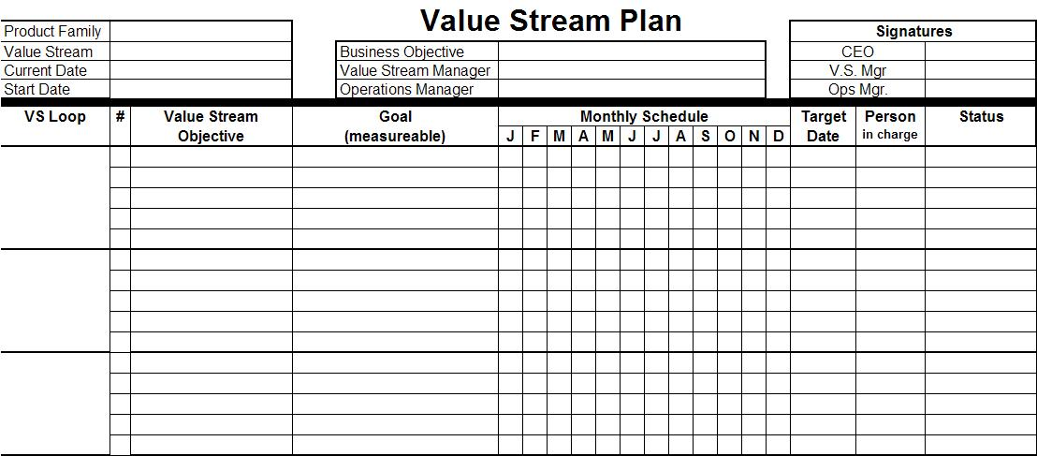
The Value Stream Plan
Notes:
DO: Review the fields of the Value Stream Plan.
Document Product Family and Value Stream – this clearly identifies which products are included in the VS Plan and specifies the scope.
Dates: Identify the date the plan was established and the date the improvement efforts will kick off.
Business Objective: Succinctly state the objective of moving to the Future State
Value Stream Mgr and Business Unit Owner – The VS Mgr is responsible for the value stream and insuring that the necessary improvements are made in accordance to the schedule.
The Business Unit Owner – Is the person responsible for the overall business unit the contains the value stream.
VS Loop- Specify loops on the Value Stream Plan – this should come directly from the Future State Map.
Value Stream Objective – Identify what needs to be done to move from the current state to the future state. The emphasis should be on what, not how this will be accomplished. The objective should describe what the end state looks like
Goal – Develop goals that will allow you to identify when the VS Objective has been achieved. Consistent performance at the goal level indicates that the objective has been satisfied.
Target Completion Dates – Identify the date to achieve the VS Objective/Goal. Keep in mind the interrelationships that exist between the objectives and prioritize appropriately. There is not always a 1 to 1 relationship between kaizen activities and objectives. A single objective may require multiple kaizens to reach the goal.
Owners of the Value Stream – High enough in the organization to effectively prioritize the objective. Insures that sufficient resources are invested to reach the goal. Eliminates any obstacles and follows up with the team to ensure timeline is maintained.

Slide 13
VSM in Context
Develop Value Stream Plan
VSM is an incremental and repeatable cycle
VSM implementation cycles should support business’ long-term “vision”
Approx. ½ of time span from now to Future State
VS Plan
Implementation
Convergence
of future VSM and
long-term “Vision”
transformation
VSM
“Event”
New
VSM
“Event”
Kaizen events and other improvement and transformational activities
New
Value Stream
Plan
Value Stream
Plan
Future-State
VSM
New
Future-State
VSM
Begin implementation of
pacing transformation activities
(>6 months) required to achieve
long-term “vision”
Long-term
Vision
13

Slide 14
Role of Leadership in VSM
Define and communicate the long-term “vision” for the business regularly
  No sense in making short term improvements to a process that may be outsourced, eliminated or fundamentally transformed in the near future
Identify key value streams to be addressed by the business
  Prioritized according to business need and strategy
  Not every business process will need to be addressed by VSM
Provide sponsorship and support for VSM events and implementation
  Internal/external resources and funding
  Executive decision-making
  Empowerment of teams
Notes:
DO: Review points on the slide.

Slide 15
Role of the Value Stream Manager
The Value Stream Manager is the business process “owner”
Oversees, charters and typically leads VSM events
“Owns” the Value Stream Plan
  Responsible for overseeing the completion of kaizen and other CI improvement activities that are identified on the VS Plan
  Provides leadership in resolving issues and removing obstacles that affect reaching the future state in the prescribed timeframe
Notes:
DO: Review points on the slide.

Slide 16
Role of the Value Stream Manager
“Owns” the operational aspects of the end-to-end process, even if it crosses organizational boundaries
  Reports (solid or dotted line) to the level where all VS processes and functions report to
  Ensures that the future state operational model is viable and achieves the benefits envisioned during the VSM event
Continues the VSM process through the second and subsequent cycles
Maintains the linkage between VSM and strategic vision of the business
Notes:
DO: Review points on the slide.

Slide 17
Site Plan
Sample Site Plan excerpt showing scheduled events from two different Value Streams (New Mortgage and Debt Consolidation)
WEEK | AREA/CELL | VSM | TOOL | VS Plan Number | STATUS | SENSEI | COMMENTS
3-Jan | Mailroom | New Mortgage | Standard work | 3 | complete | Clem | see kaizen results sheet
3-Jan | Data Entry | New Mortgage | Standard Work | 8 | complete | Clem | see kaizen results sheet
10-Jan | Data Entry | New Mortgage | Supermarket | 4 | complete | Clem | PRE-RUN Kanban Calculator
10-Jan | Underwriting | Debt Consol | Standard work | 6 | complete | Clem | see kaizen results sheet
17-Jan | NO EVENTS |  |  |  |  |  | Clem out
24-Jan | Package Preparation | New Mortgage | Standard Work | 2 | complete | Clem | DEMAND QUESTIONS
24-Jan | Mailroom | Debt Consol | Standard work | 1 | complete | Clem | DEMAND QUESTIONS
A single plan and schedule of all kaizen and continuous improvement events for a particular facility.
Notes:
SAY: “This is a sample of an excerpt from a site plan showing scheduled events from two different Value Streams (New Mortgage and Debt Consolidation).”

Slide 18
Other Modules In This Series
5S
Standard Work
Total Productive Maintenance (TPM)
Cell Design/ Production Preparation Process (3P)
Intro to Lean
Kaizen
Kanban
Problem Solving
Poka Yoke Quality Systems
Process Mapping
Single Minute Exchange of Dies (SMED)
Transaction Process Improvement (TPI)
Value Stream Mapping (VSMi®)
Visual Management
For More Information Please Contact:
Mark DeLuzio, President and CEO
+1.860.234.0915
mark.deluzio@leanhorizons.com
Strategically Creating Value Through the Elimination of Waste
18

